Slide 1
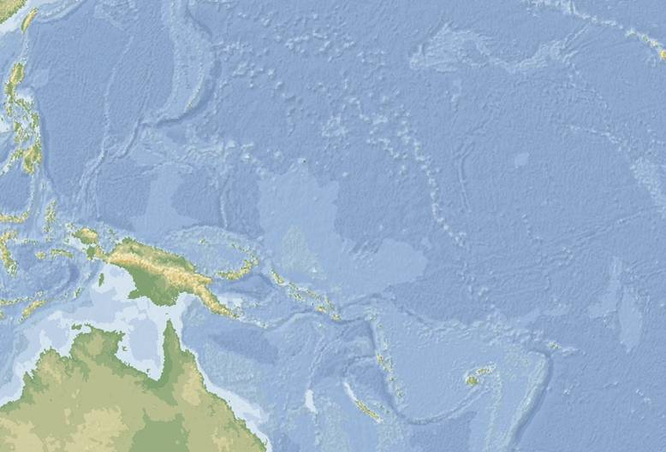





The Effectiveness of Locally Managed Marine Areas (LMMAs) in Fiji
Alifereti Tawake¹, Stacy Jupiter², Fulori Waqairagata³, Cody Clements³, Ron Vave⁴, Apisai Bogiva⁴, Semisi Meo⁴, Patrick Fong⁴, James Comley⁴, Bill Aalbersberg⁴ & Lavenia Tawake⁵
¹School of Environmental Science, James Cook University
²Wildlife Conservation Society Fiji
³School of Marine Studies, University of the South Pacific
⁴Institute of Applied Science, University of the South Pacific
⁵University of Sunshine Coast, Brisbane
International Coral Reef Society, Cairns, Australia
9th July, 2012

Slide 2
OUTLINE OF TALK
Concept
Background: FLMMA
Method of Evaluation
Results
Conclusion
Acknowledgement

Slide 3
CONCEPT
Are Locally Managed Marine Areas (LMMAs) in Fiji achieving their intended outcomes to communities?
  Ecological benefits
  Socioeconomic benefits

Slide 4
Background
Fiji Locally Managed Marine Area (FLMMA) Network – started 1997, formalized in 2001, registered as a non-charitable organization by 2004
2012:
  20 partner organizations (4 Govt, 13 NGOs & 2 Universities)
  1 MPA (1997) > 386 MPAs (2012)
Dual governance
- government, science-based decisions
- communities, traditional management practices
Overfishing driven by population growth and efficient technology , made worse by climate change

Slide 5
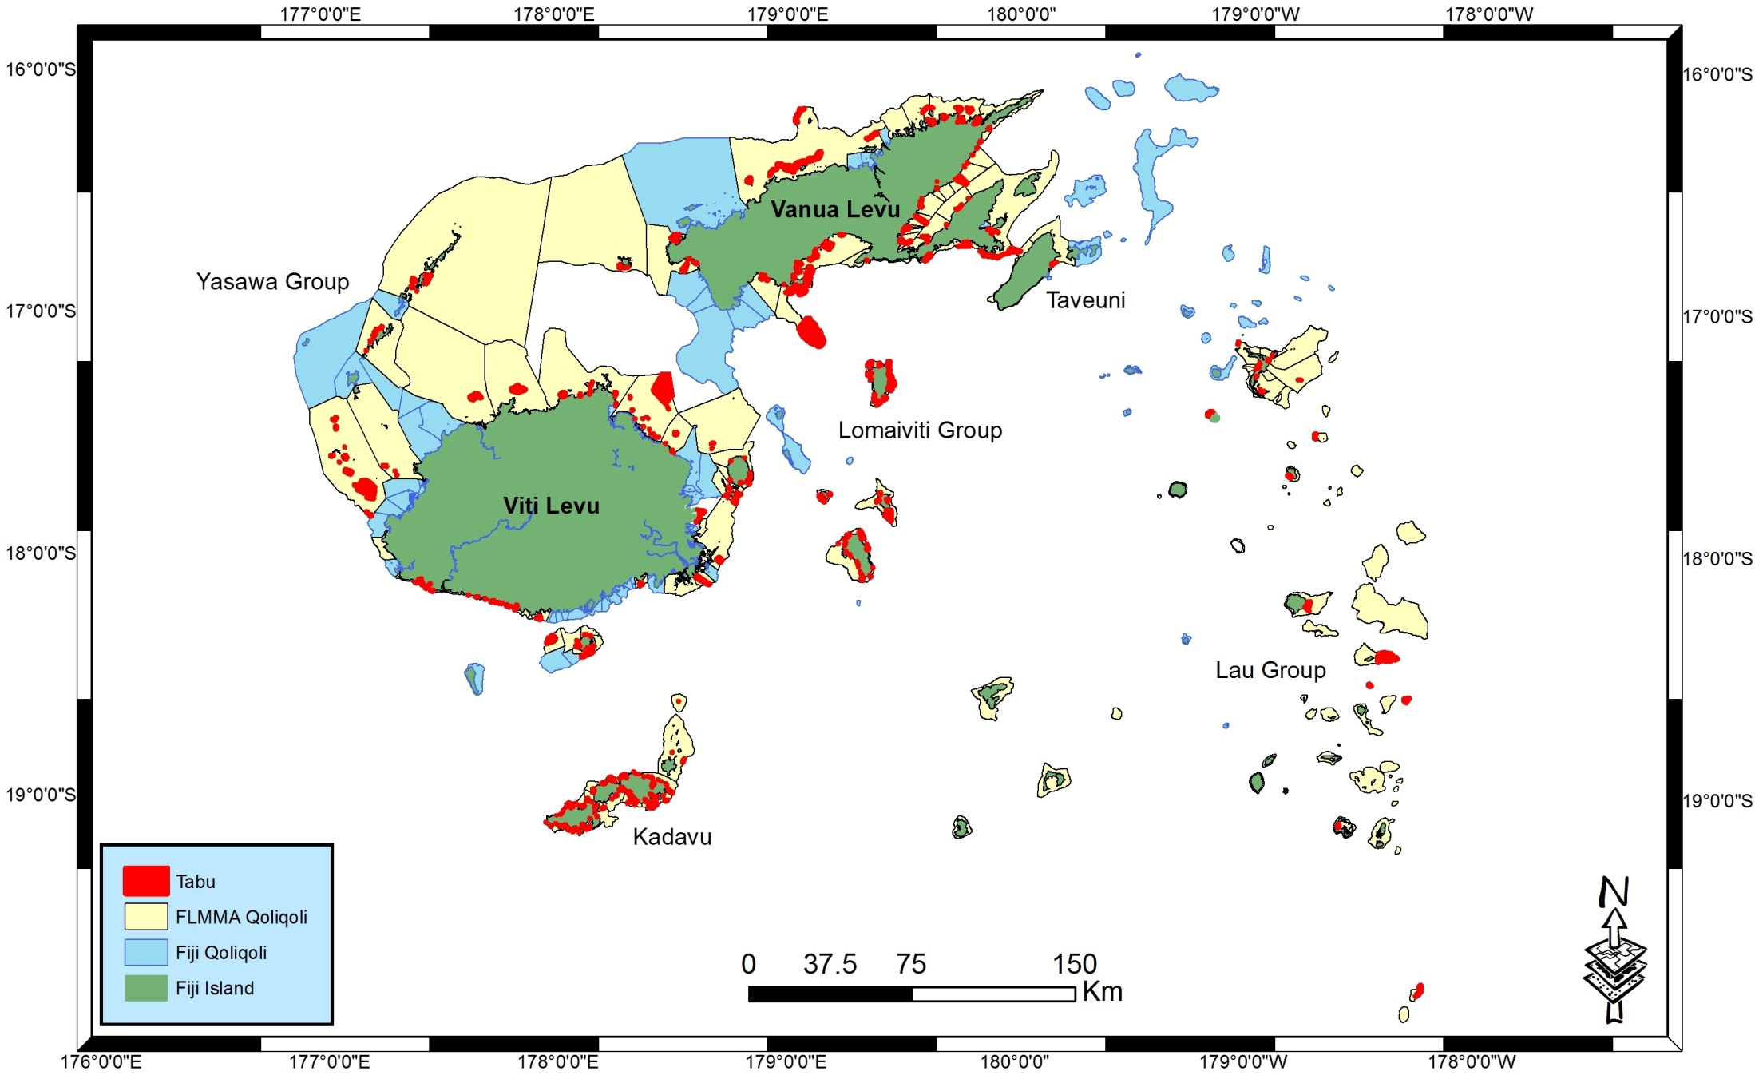
FLMMA works in 47% or 192 of Fijis 410 fishing grounds
By 2012: 386 Tabu or MPAs (in red)

Slide 6
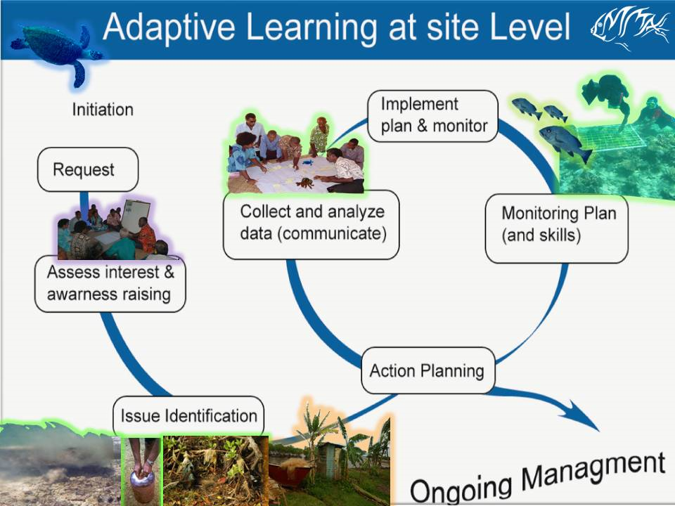
6
1
7
5
2
4
3
Notes:
LMMA uses CBAM approach

Slide 7
Method of Evaluation
LEVEL 1 (Anecdotal): Preliminary observation
LEVEL 2 (Community data) : Preliminary observations
LEVEL 3 (Rigorous scientific data): Some results
  Tawake et al (JCU): 30 FLMMA sites with at least 5 years of engagement chosen & also a learning site
  Stacy Jupiter (WCS-Fiji)
  Cody Clements (USP Masters)
  Fulori Waqairagata (USP Masters)
Assessment methods includes:
  Diagnosis & content analyses of versions of mgmt plans
  Scientific literature on FLMMA sites
Research uses ‘Before/After or Control/Intervention (BAI)’ design
Notes:
To address this question further, we will look at some preliminary results from the assessments by AT (part of his study) and IAS team on FLMMA’s progress over the last 10 years

Slide 8
Intended Outcomes of Community Management Plans (Purpose of having MPAs)
More fish to eat
More income from fishing
Restore degraded reefs and depleted species
Provide opportunities to develop alternative income sources
Protect fish aggregation sites
Foster social and community relations
Revive traditional practice, knowledge & language
Tawake et al 2011

Slide 9
Theory of Change: Intended pathway to influencing communities livelihoods
Tawake et al 2011
Protection strategy – Ecosystem (Yaubula) management including LMMA strategy and tools
Protection strategies
Safe haven
Reseeding and spillover
More Fish & Catch
Improved Livelihoods
Healthy Qoliqoli
Source of food & More income

Slide 10
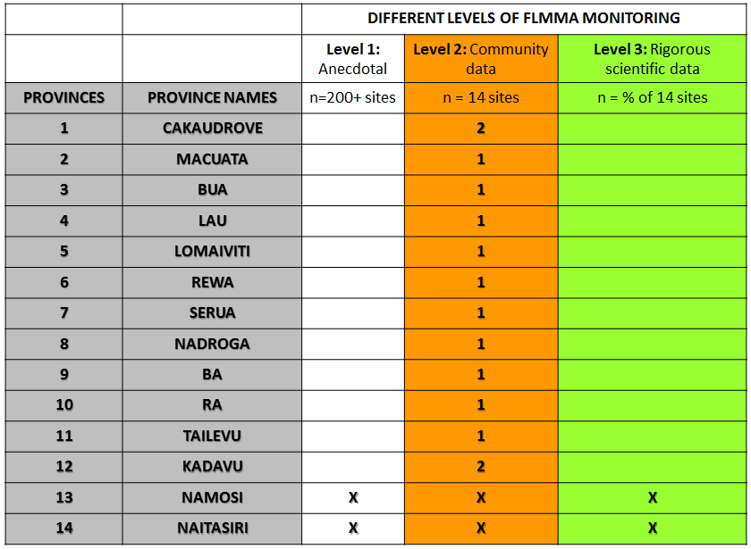
●
●
●
●
●
●
●
●
●
●
●
●
●
●
●
●

Slide 11
RESULTS:
Improved fish abundance & biomass
  Significantly greater density of total fish abundance inside MPAs (Pre-harvest of Kia Island MPA) – Jupiter et al 2012
  Significantly greater amount of total fish biomass inside MPAs (Kubulau & Kia Island MPAs)
  Significantly greater density of targeted fish abundance inside MPAs (Goetze et al, 2011) – Namena Island (Bua)
  Significantly greater amount of herbivorous fish inside MPAs resulting in increased grazing thus leading to reduction in macroalgae (Waqairagata et al, 2011)

Slide 12
More herbivorous fish inside MPAs
Waqairagata et al 2011
MPA
Fished Area

Slide 13
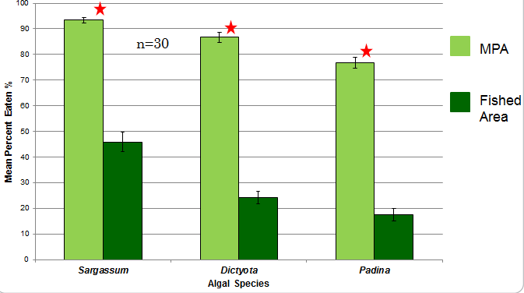
More herbivorous fish inside MPAs = More grazing
(Improved habitat health)
Waqairagata et al 2011

Slide 14
Improved fish catch (Mgmt plan review)
Tawake et al 2011

Slide 15
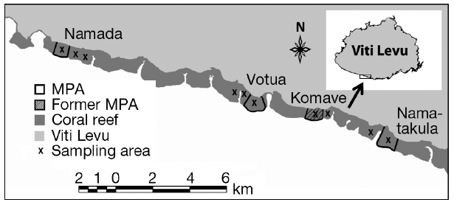
Improved fish catch
  Significantly greater CPUE/BPUE inside MPA
  Significantly greater catch diversity within intact MPAs
  Significantly greater proportion of fish above size reproductive maturity in MPAs
Clements 2012

Slide 16
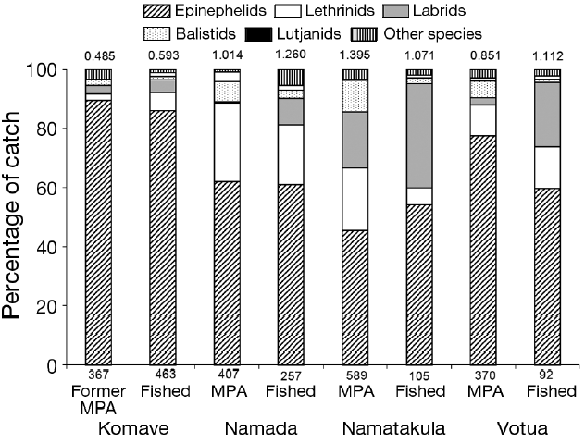
Greater catch diversity within intact MPAs
Significantly greater catch diversity within intact MPAs
Clements 2012

Slide 17
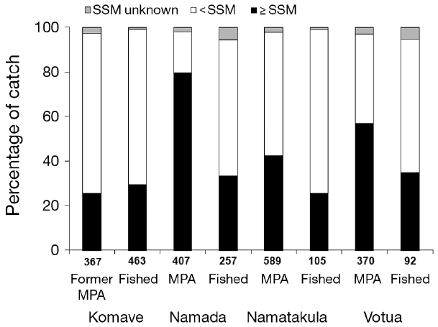
More mature fish in MPAs
More sexually mature fish in MPAs except in Komave
Clements 2012
Size at Sexual
Maturity (SSM)

Slide 18
LMMA- Improving Household Income growth
Tawake et al 2011

Slide 19
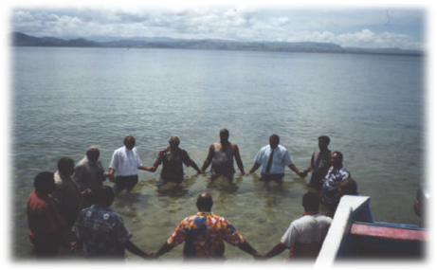
Unity and Social Cohesion
Tawake et al 2011
Notes:
Chiefs, clan and religious leaders of Votua (Ba) holding hands in a show of unity & commitment towards the ‘Bai kei Votua’ project, LMMA plans and its objectives and vision during an emotional ceremony to bless their tabu area. Photo by Alifereti Tawake, 2002

Slide 20
DISCUSSION:
Contributing factors for Success
  CBAM has transformed decision making of natural resources from autocratic to participatory & democratic
    From chiefs to “village yaubula (natural resource) committees”
  Social customs that facilitate compliance within closures
  Exclusive & locally recognized tenure over marine resources
  Relatively small human populations
  Distance away from fishing villages
  Innovative selection of fish wardens = licensed fishermen

Slide 21
NEGATIVE EVIDENCE
No significant difference in total fish abundance inside MPAs (Goetze et al 2011 – Kubulau & Namuri)
No significant difference in total fish biomass inside MPAs (Jupiter & Egli 2011 – some Kubulau MPAs & only in some years)

Slide 22
DISCUSSION:
Contributing factors for non-success
  Small size of closures
  Short duration of closures
  Non-compliance with management rules
  Disclosure of management success to fishers from villages with high reliance on fisheries products

Slide 23
Conclusion
The Fiji study revealed that some LMMA sites are showing improvements, both ecologically & socioeconomically, thus meeting communities needs and therefore being effective
That the effectiveness of some LMMA strategies are reduced or nullified with uncontrolled opening of the MPA
That preliminary scientific data validates some FLMMA communities perception of improvements. That perhaps, community monitoring data, though not highly accurate & cheap to undertake, are giving similar results to rigorous scientific studies
  Question is: should decision making of a communities natural resources await rigorous scientific data or can it be based on the ‘best, available community data’?

Slide 24
Acknowledgements
All FLMMA partners and sites for willingness to take part in the assessment (Tawake et al)
Scientific literature (Cody Clements, Stacy Jupiter & Fulori Waqairagata)
FLMMA & LMMA Network Learning group
David & Lucille Packard Foundation, United Nations University (UNU), Foundation of Success, CRISP/SPREP for the partial funding support that enabled this assessment.
James Cook University, USP-IAS and CSIRO for supporting PhD study (Alifereti Tawake)

